Slide 1

Dennis, Furkan, Jonas, Josha, Max

Slide 2
Project Goals
Platform Development
Community Building
Resource Sharing
Event Information
Interactive Communication
User-Friendliness
Privacy and Security
Scalability

Slide 3
Project Vision
‘DHBWhub’ is a website and Q&A-platform for students and other interested people, particularly regarding the corporate state university DHBW and its courses. Students can discuss questions or talk about other things relating to the organization of the university classes or other leisure activities.

Slide 4
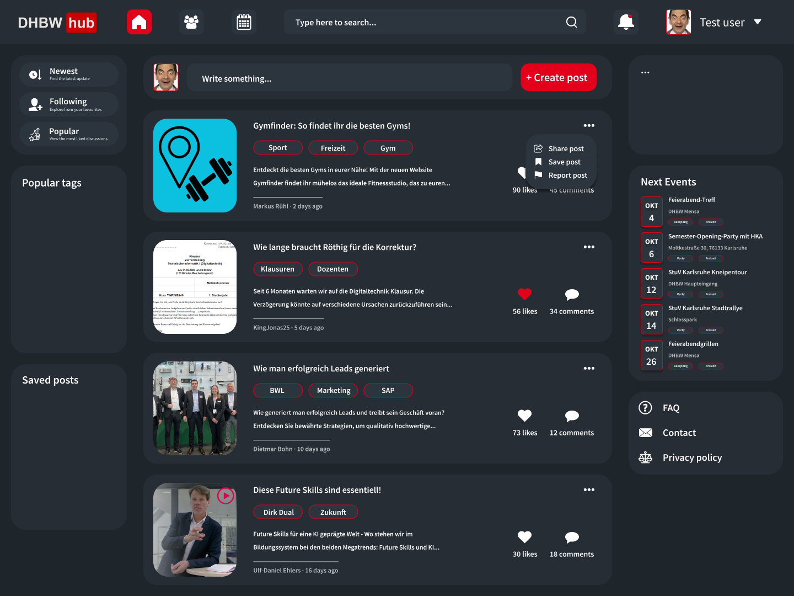
What we plan to deliver

Slide 5
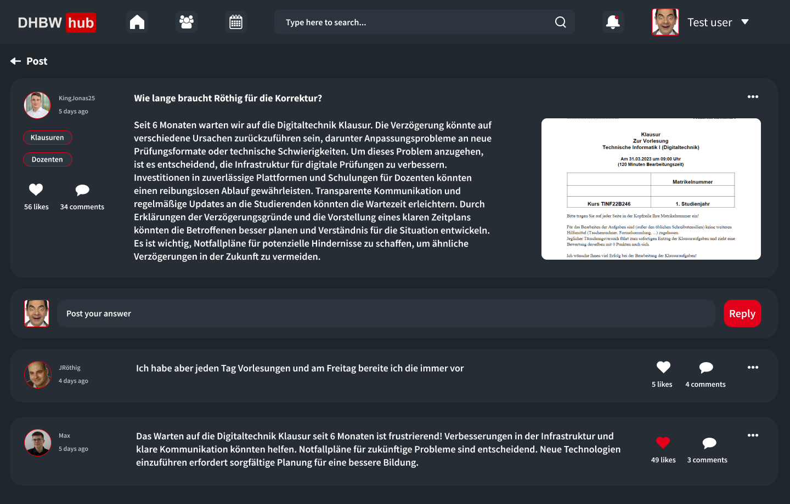
What we plan to deliver

Slide 6
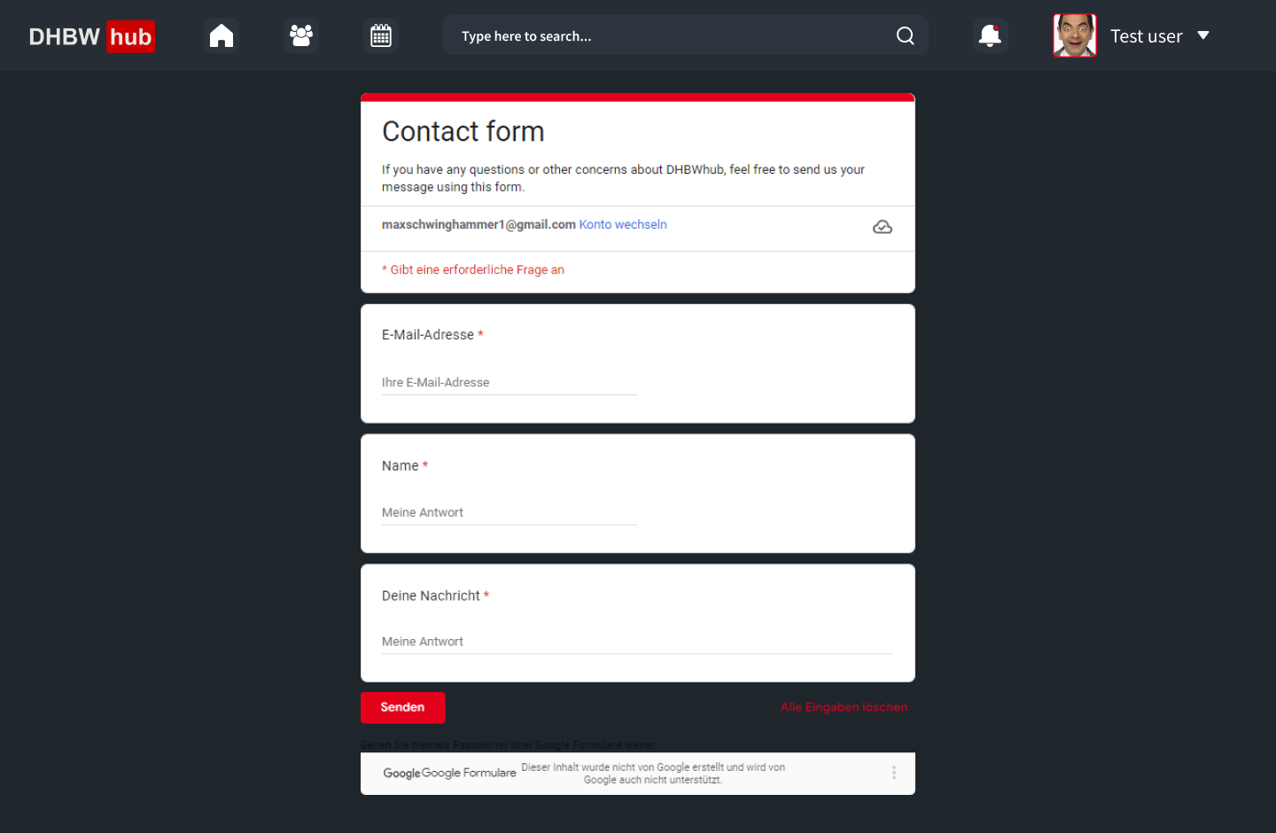
What we plan to deliver

Slide 7
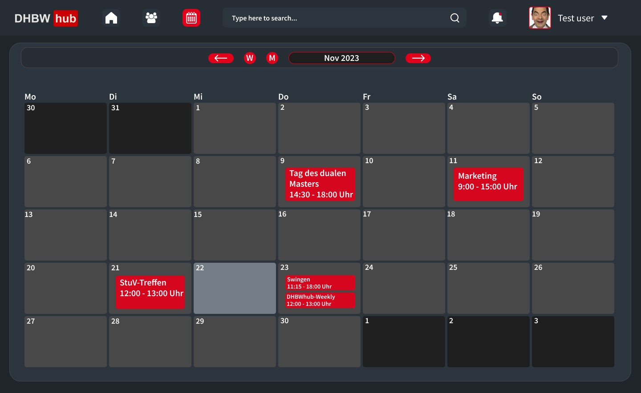
What we plan to deliver

Slide 8
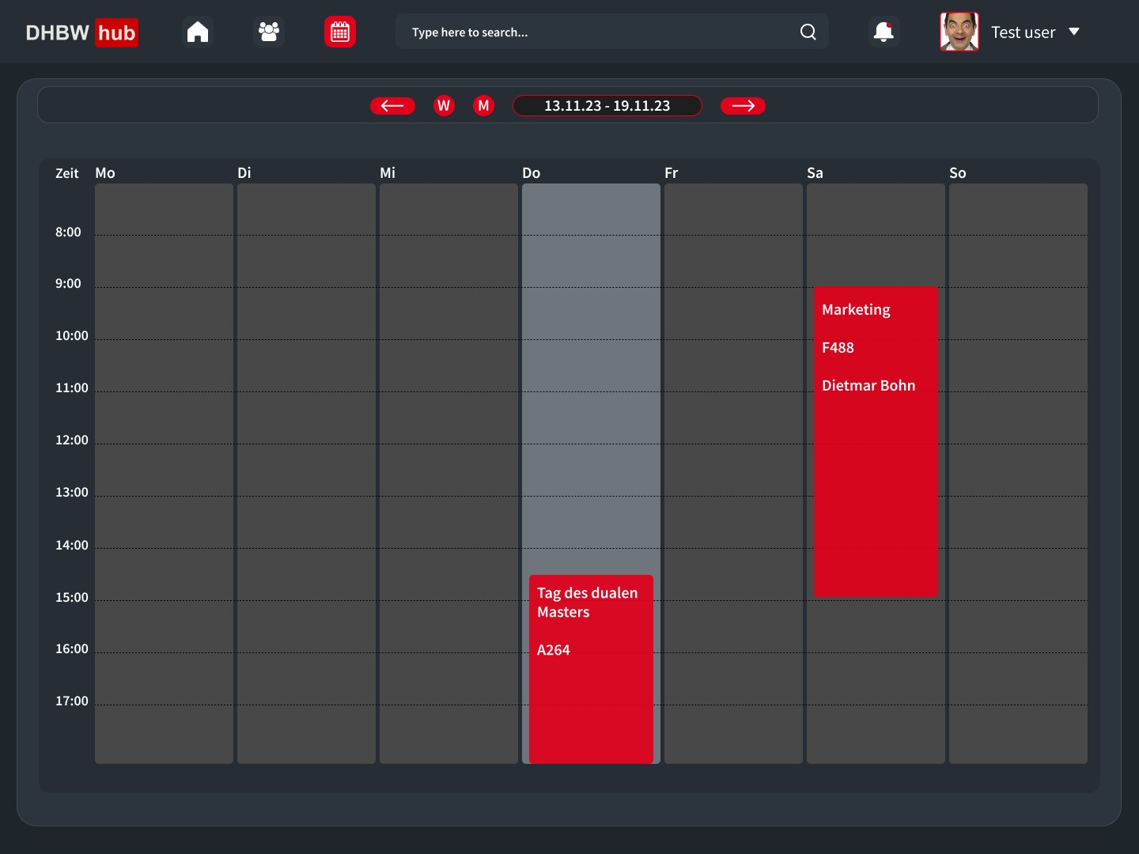
What we plan to deliver

Slide 9
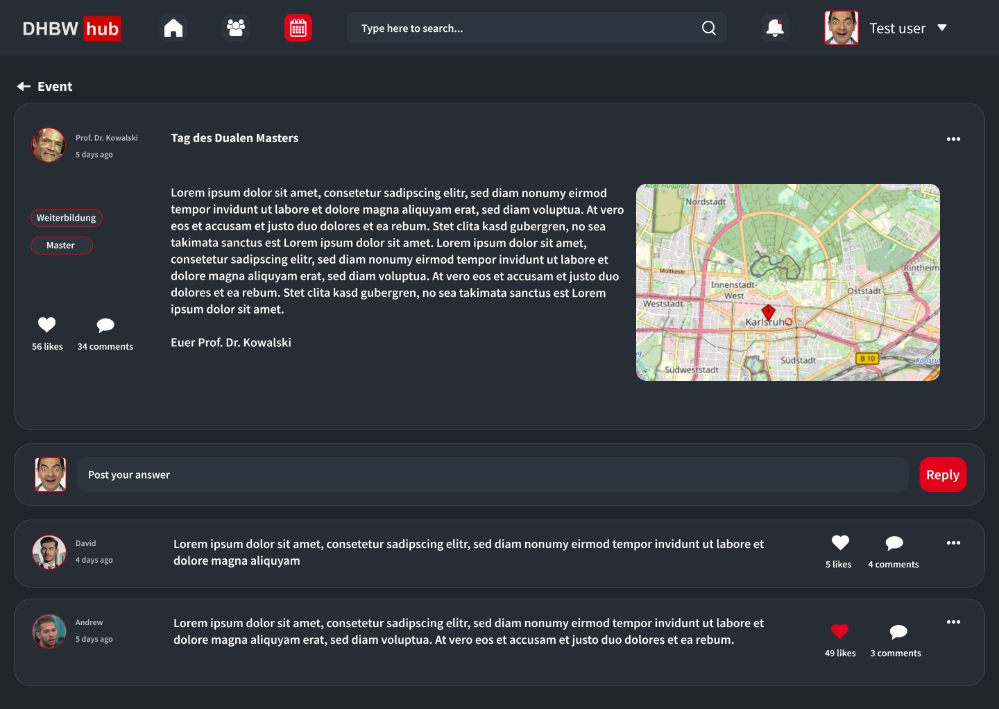
What we plan to deliver

Slide 10

Project management – Setup
Josha - PO
Dennis - SM
Dailies on Mondays and Thursdays
Weeklies on Tuesdays
Sprint Review, Retrospective and Planning on every second Thursday
Discord for Weeklies and Refinement
WhatsApp for short information sharing
GitHub for Project management
Furkan
Jonas
Max
Developers

Slide 11
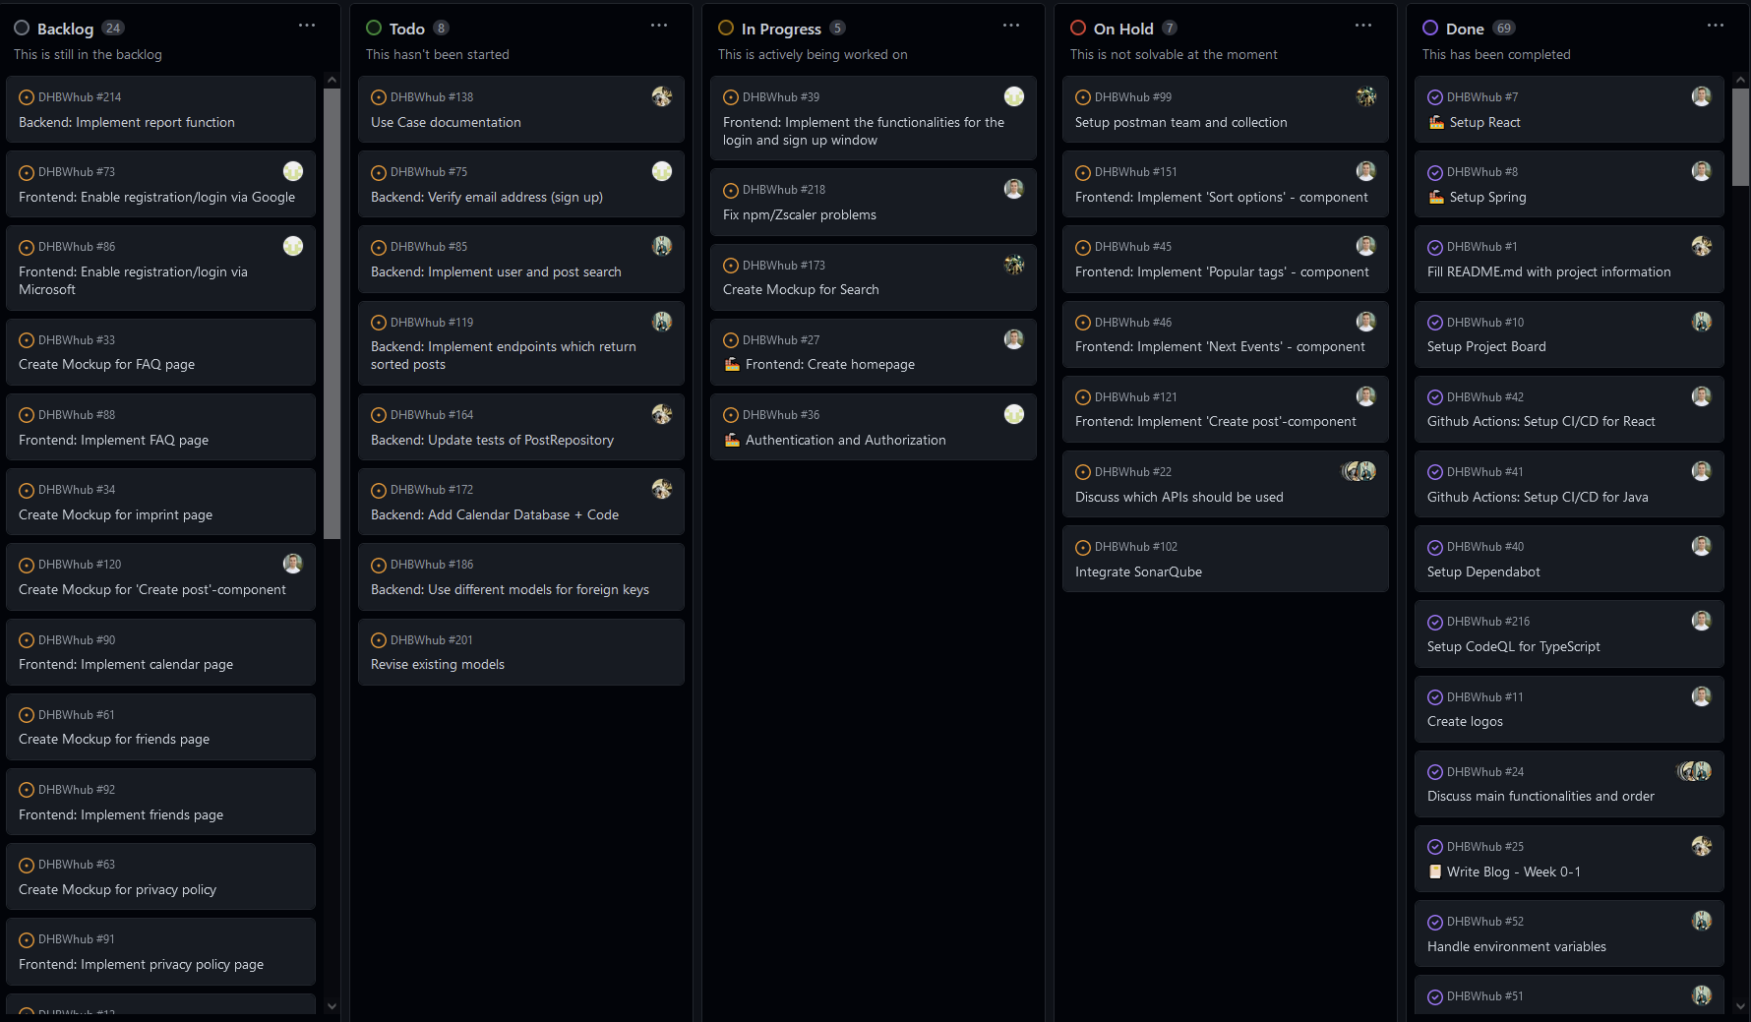
Project management – Setup

Slide 12
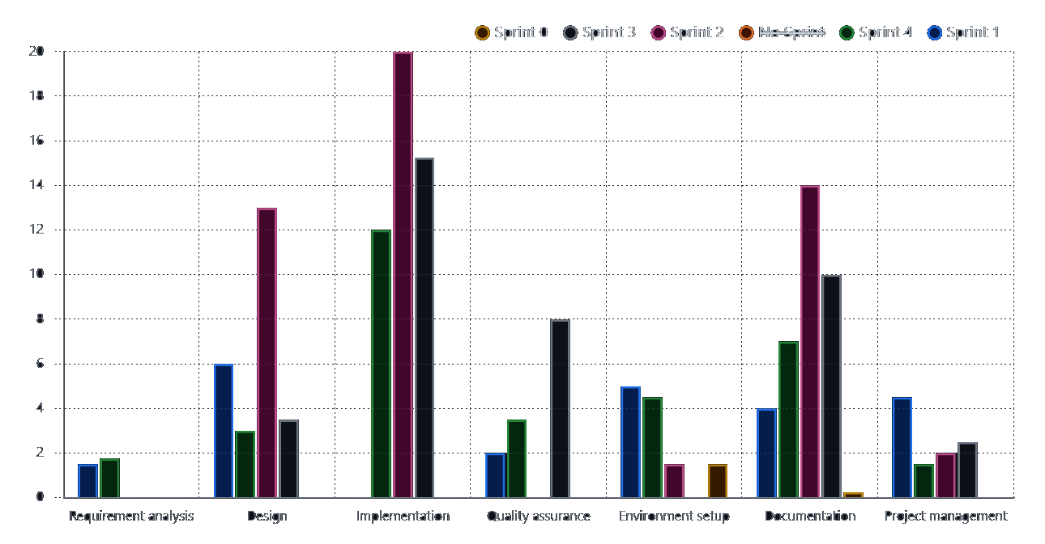
Project management – Setup

Slide 13
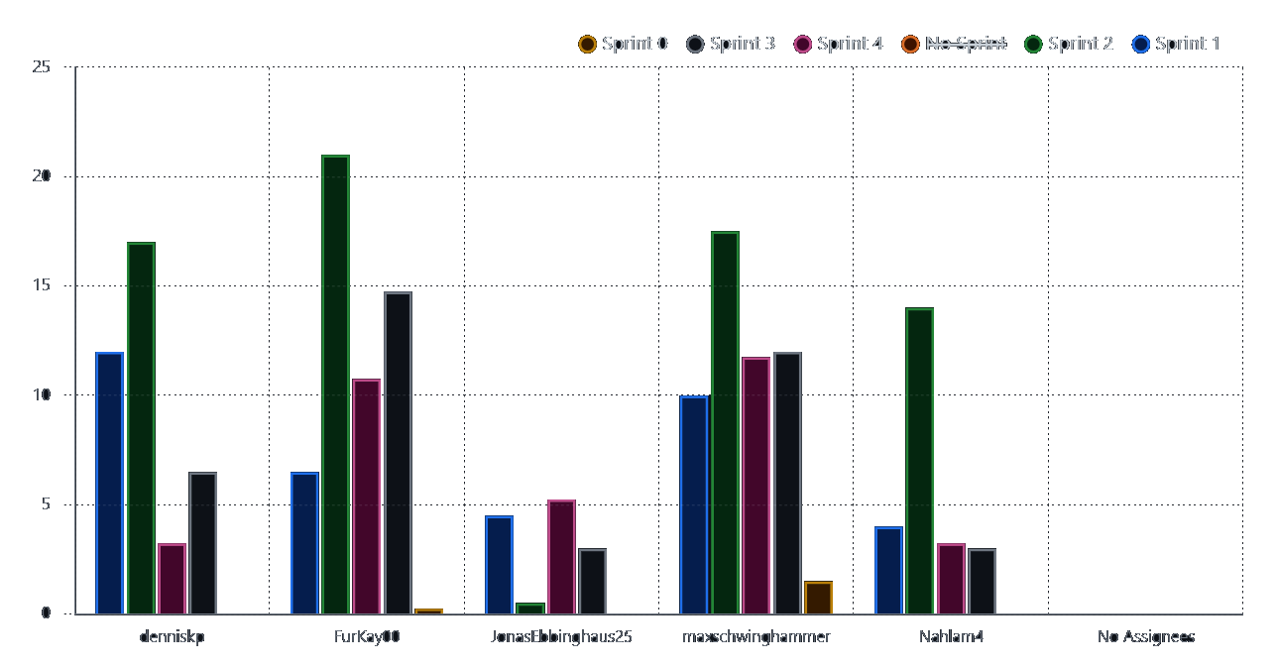
Project management – Setup

Slide 14


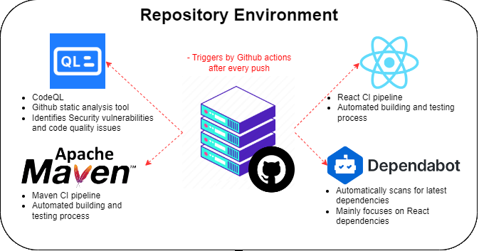
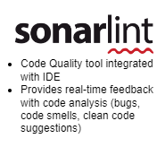
Project management – CI/CD

Slide 15



Identifying our entities – Profiles
Gaining access to the website
Information for authentication (e.g username, email and password)
Optional profile picture
Distinguishing administrator from end user
Different roles
End user is more personalized
Account
End user
Administrator

Slide 16
Identifying our entities - Segmentation
Categorization of end users
Ensuring suitable content
Faculties:
Economy, technology and health
Courses:
Part of Faculty
End user participates in one e.g. ‘TINF22B6’
Faculties
consists of
participates in
End user
Courses

Slide 17



Identifying our entities - Interaction
Interaction through posts and comments
Post:
Created by end user
Option to save several posts
May contain pictures
Users can like and share them
Comment:
Belongs to a single post
Users can like them too
creates
Post
End user 1
belongs to
writes
Comment
End user 2

Slide 18
Identifying our entities - Summary
Account
Picture
Optional
Is either
Administrator
End User
Create, save, like, share
Post
Belongs to
Belongs to
Part of
Create
Faculty
Course
Comment

Slide 19
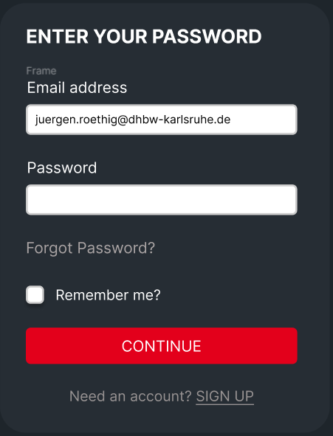
Design pattern: MVC
User
View
Model
Interacts with
Account
e.g. user Data
Sends Interactions
Controller
Spring Web Services

Slide 20
Design pattern: Interface Segregation
ClientUserController
AdministratorController
uses
uses
AccountService
Doesn´t use
CourseController

Slide 21
Why these two?
Easy collaboration
Clear arrangement
Scalability
Maintainability
Modular

Slide 22
Live demo of current status
Implemented so far:
Header
Post (with menu)
Login (first view)
Sign Up (first view)

Slide 23
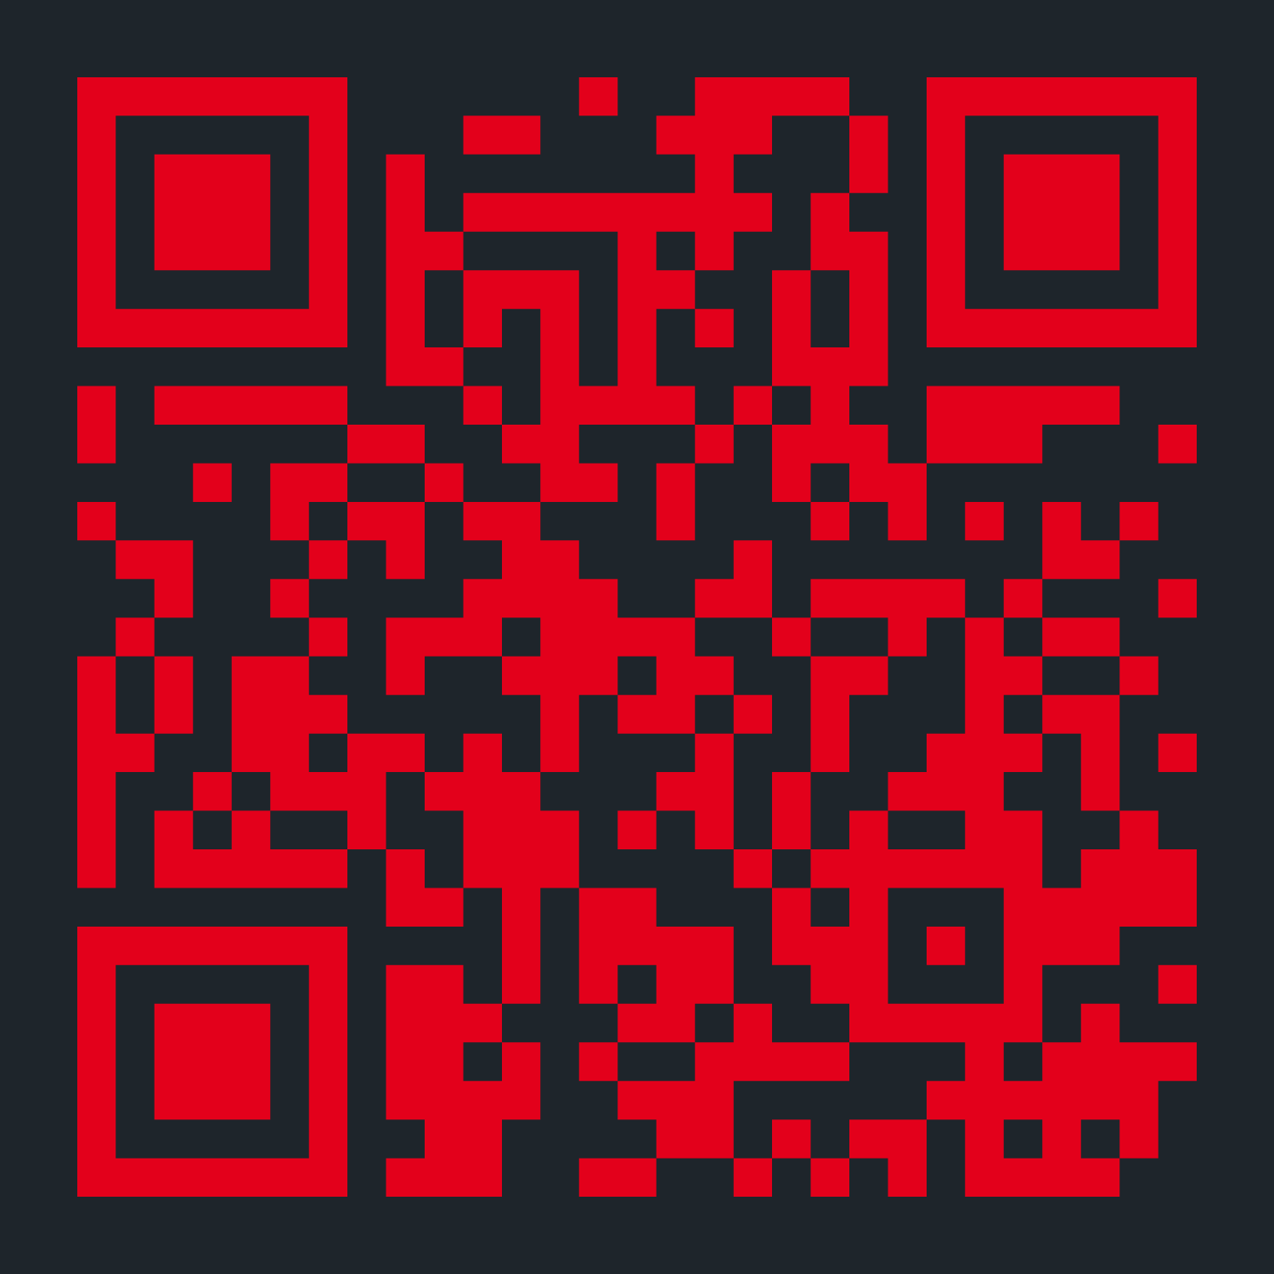

Support our project!
https://www.paypal.com/paypalme/dhbwhub

